Slide 1

EECE-5696 Special Topics
GNSS Signal Processing
A MATLAB based investigation of GDOP for satellite positioning
- Prathamesh Rege

Slide 2
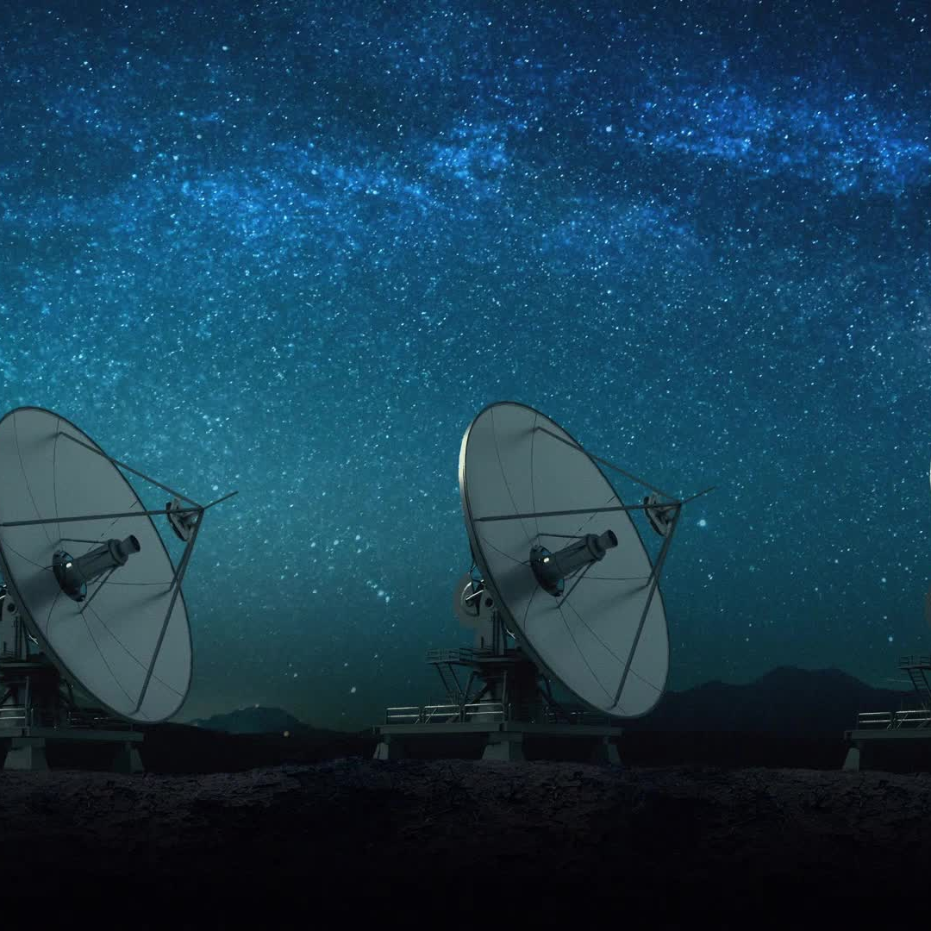
What is GDOP?
GDOP – Geometric Dilution of Precision
Measure of quality of satellite based on geometry of satellites in view
History of GDOP
Roots in early 1960s
Introduced in 1970
Party of early developments of GPS

Slide 3
Dilution of Precision (DOP)
Term used to describe the way in which geometry of the satellite affects the accuracy of the navigation solution.
Different types:-
GDOP
PDOP
HDOP
VDOP
Early GPS receivers could only track signals from four or five satellites at once, and many employed GDOP or PDOP optimization to select the satellites to track.

Slide 4
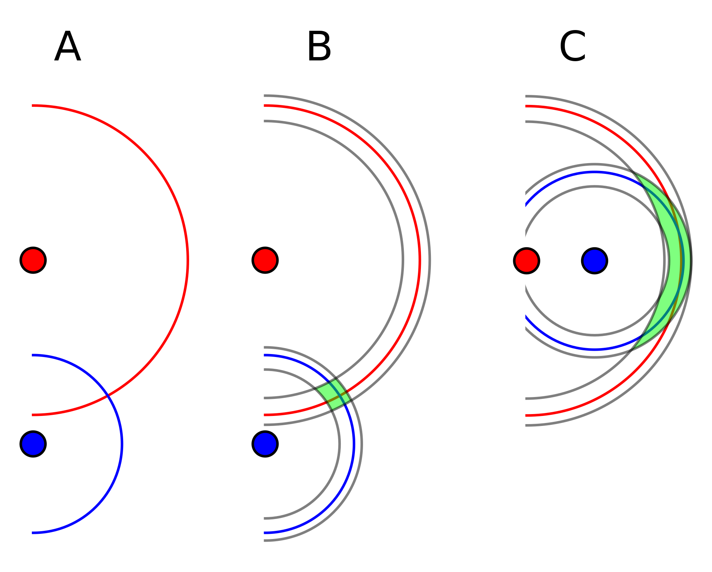
Geometric Dilution of Precision (GDOP)
GDOP Formula
Important in accurate positioning
Range (1-Inf). Good values [1,5], Moderate values(5,20], Bad values>20
Used in GPS, GLONASS, Galileo, BeiDou

Slide 5
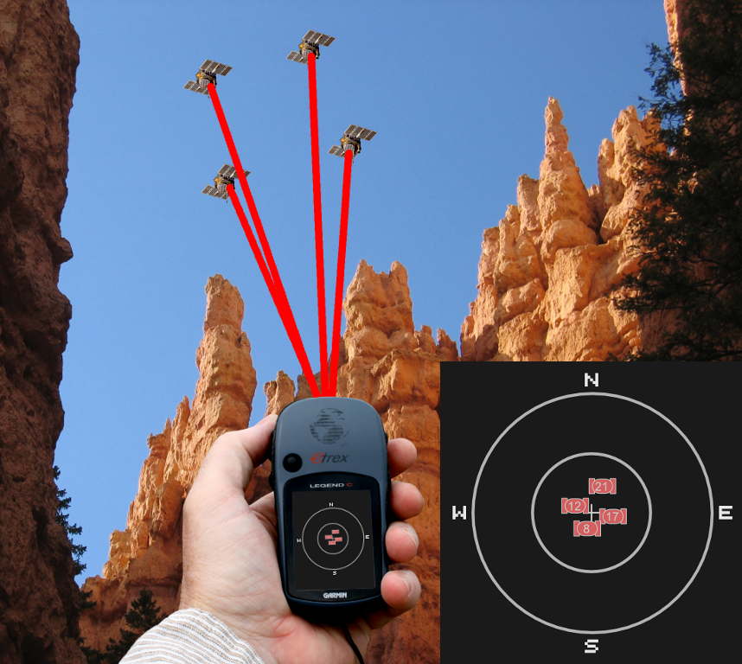
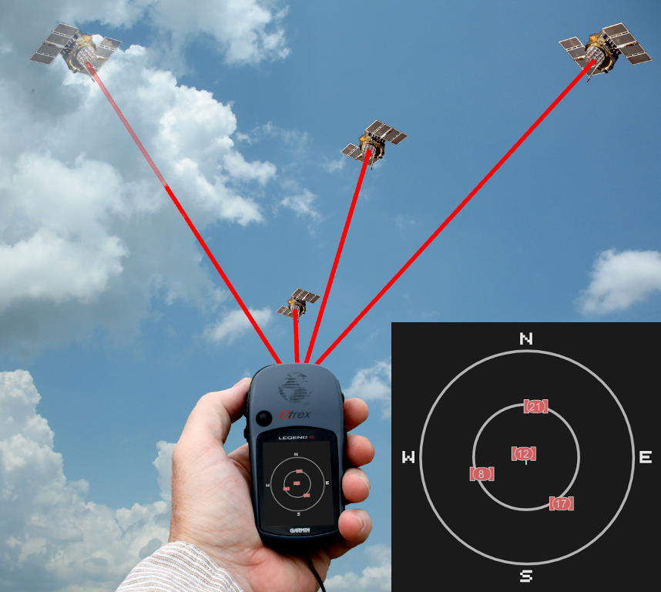
Factors affecting GDOP
(A) Geometry
(B) Number of satellites
Bad Geometry
Good Geometry

Slide 6
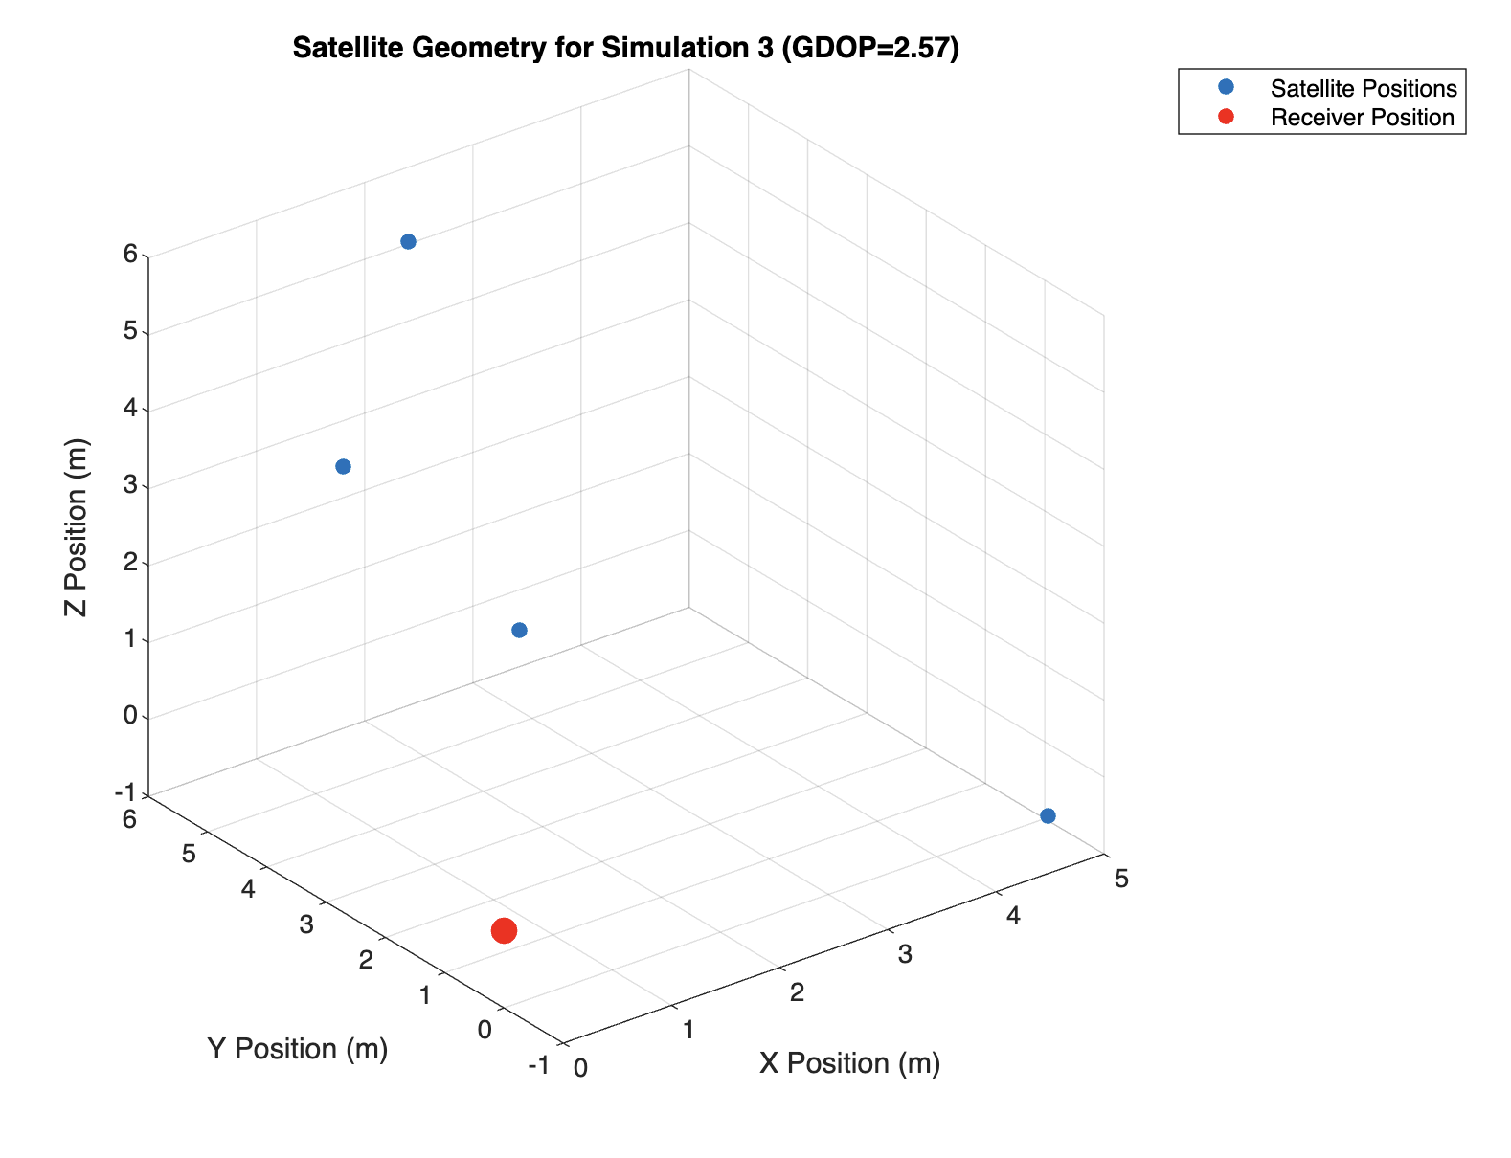
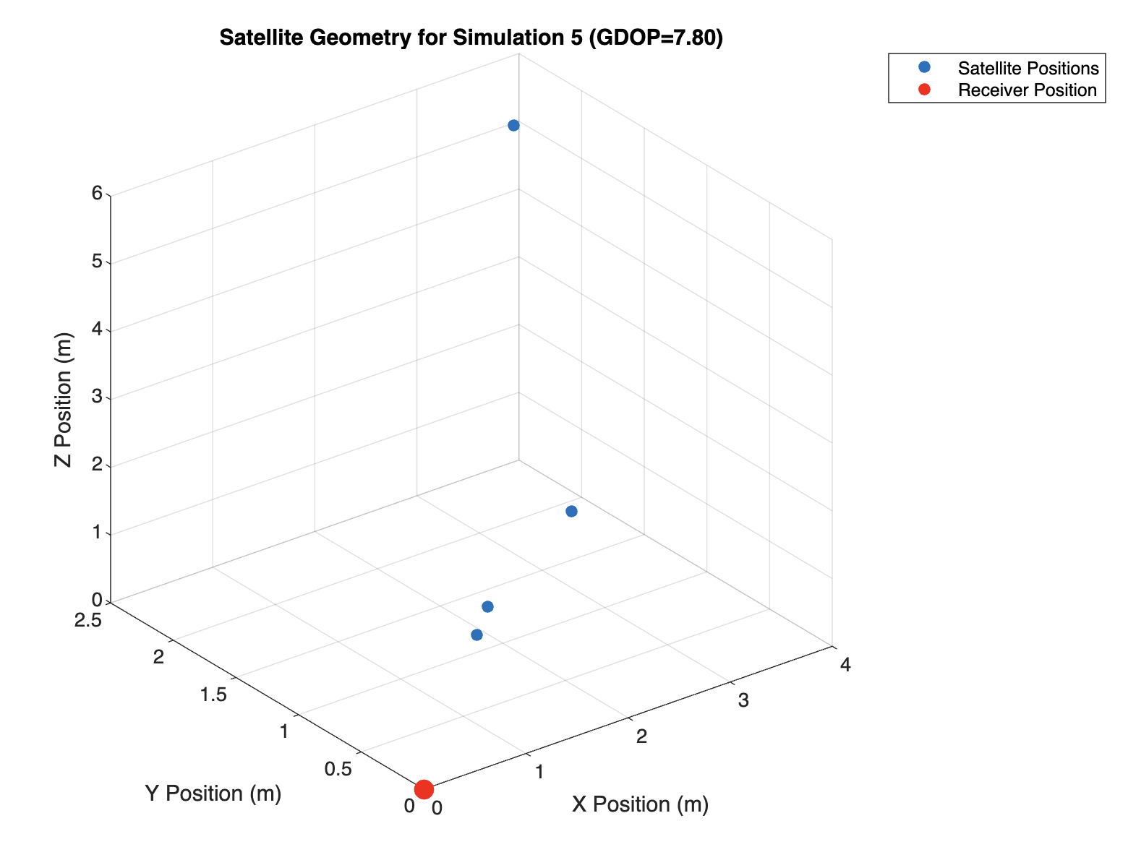
Matlab Simulation Results - 1

Slide 7
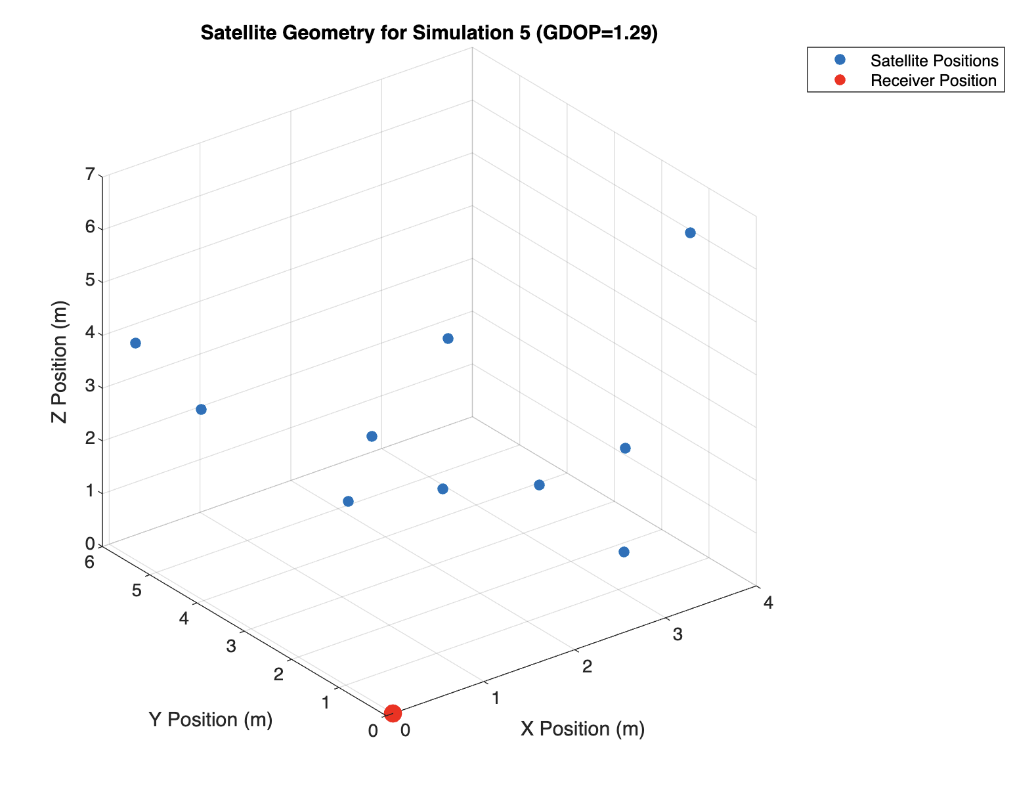
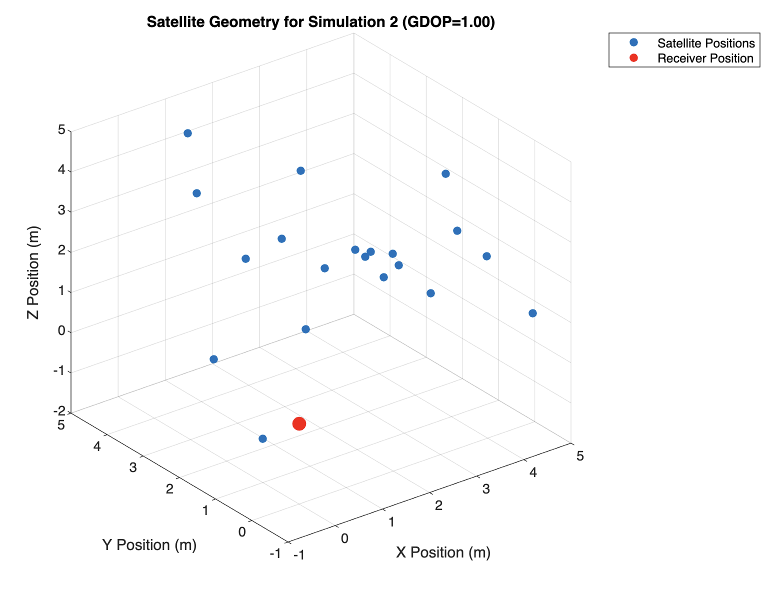
Matlab Simulation Results - 2

Slide 8
Cramer Rao Bound
Theoretical lower bound on the variance of an unbiased estimator of a parameter in a statistical model.
CRB can be expressed in terms of GDOP
Lower the GDOP, lower the CRB and higher the accuracy
Used toa assess the accuracy of the position estimate without knowing the tue location.

Slide 9

Horizontal and Vertical Errors
Horizontal Error: Difference between estimated and true position projected onto the horizontal plane.
Vertical Error: Difference between the estimated and true height
Factors Affecting the Errors: Number and geometry of satellites, receiver’s location, atmospheric conditions,etc.
Relation with GDOP

Slide 10
Drawbacks of GDOP
Limited Accuracy
Limited usefulness
Limited applicability
Dynamic nature

Slide 11

Mitigation of GDOP
Wait for Better satellite geometry
Move to better satellite visibility location
Additional satellite constellations
Use of advanced signal processing techniques
Use differential GPS/GNSS

Slide 12
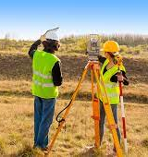
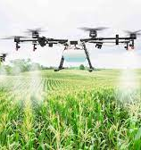
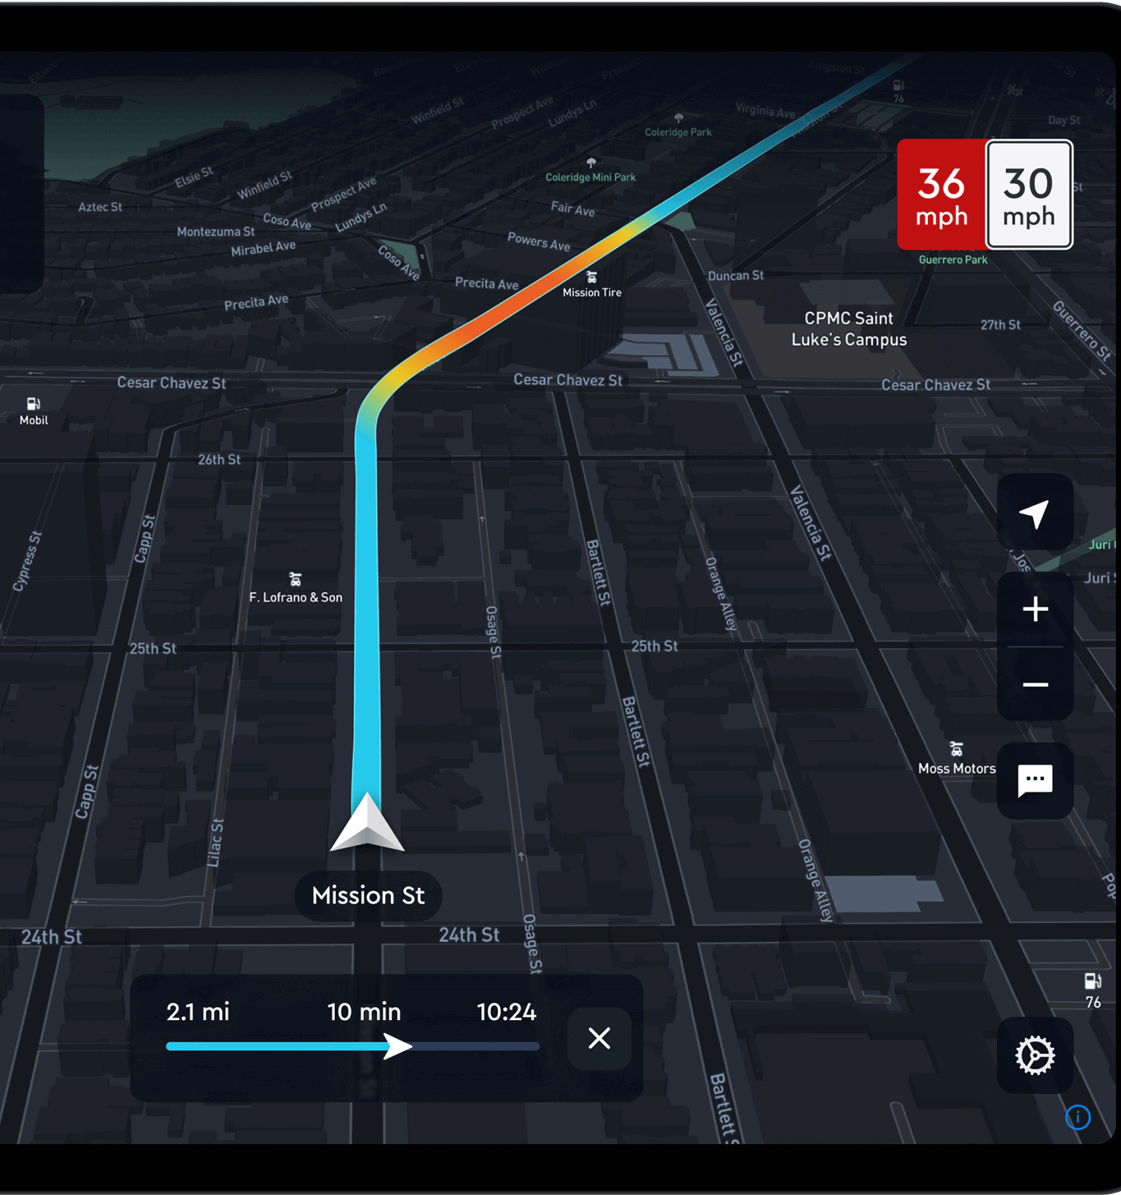
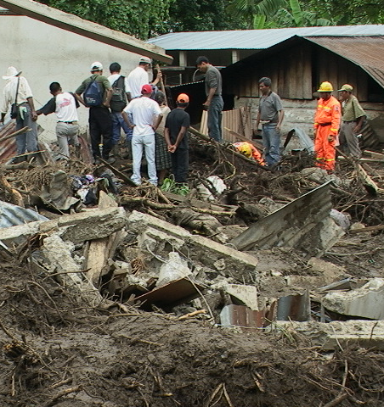
Applications of GDOP
Navigation
Surveying
Remote Sensing
Precision Agriculture
Disaster Management

Slide 13
Conclusion

